Slide 1
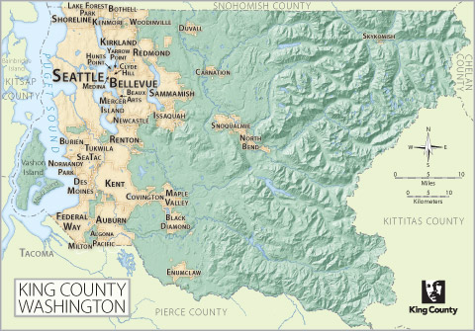
Linear Regression Modeling King’s County Housing

Slide 2
The Data
Target:
Goal is to predict: House Price
Predictor Variables:
Number of Bedrooms, Bathrooms, and Floors
Sq. footage – Internal and Lot
Overall Condition (1-5)
Geographical Location (Based on Clustering)
Waterfront (yes / no)
Year Built
Renovated (yes / no)

Slide 3
DATA
Feature Engineering
Build Model
Deploy!
Test
Model
Bad Results
Good Results

Slide 4
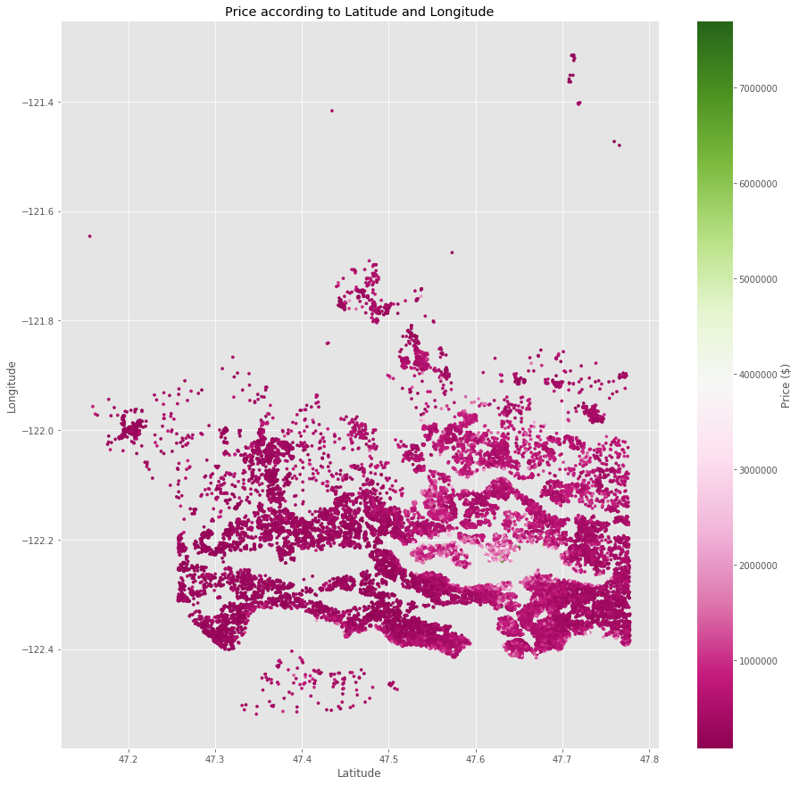
Problem: Dealing with Location Data
Price depends on exact location
Difficult to use latitude, longitude, zip code in linear model
Still want to capture affect of location in model

Slide 5
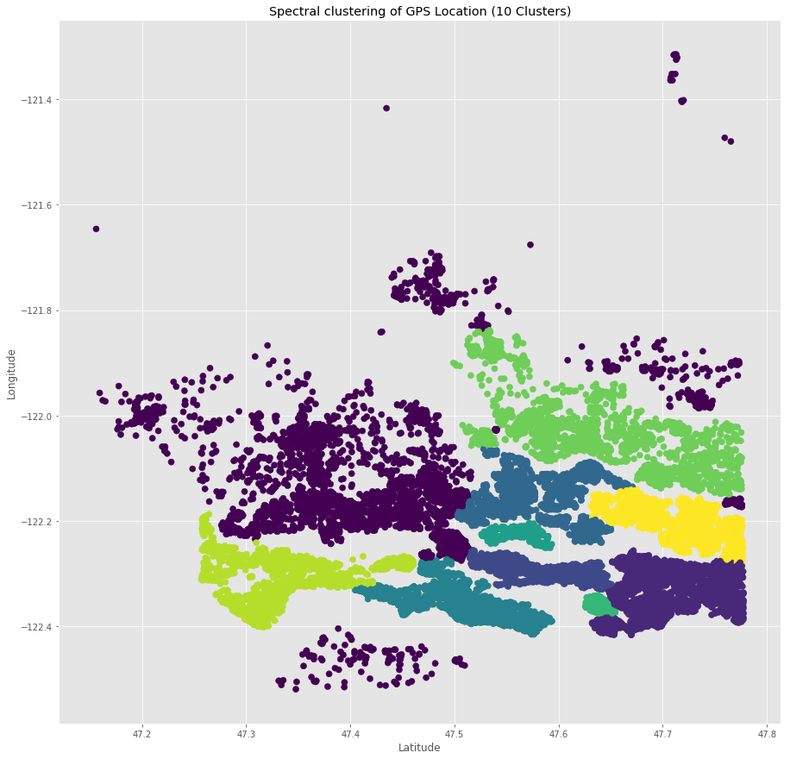
Solution: Spectral Clustering
Finds patterns in data and separates into groups
Works well with complicated patterns
Gives good way to distinguish geographical affect of price
Works well in linear model
Extracts meaning from location data

Slide 6
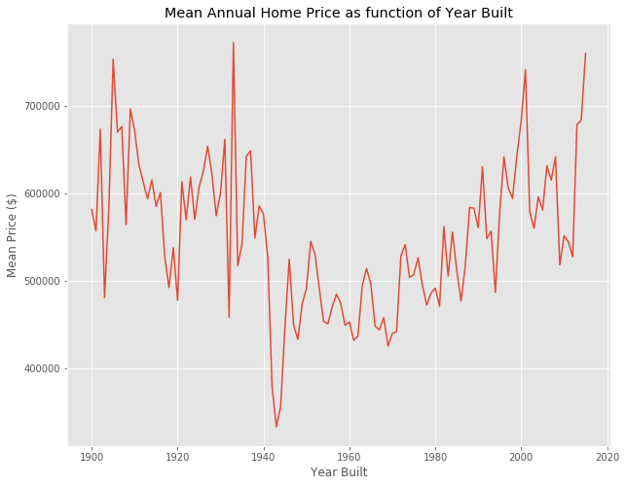
Problem: Dealing with time series data
Year built has clear affect on price
Won’t work well in linear model
Still want to capture affects in linear model

Slide 7
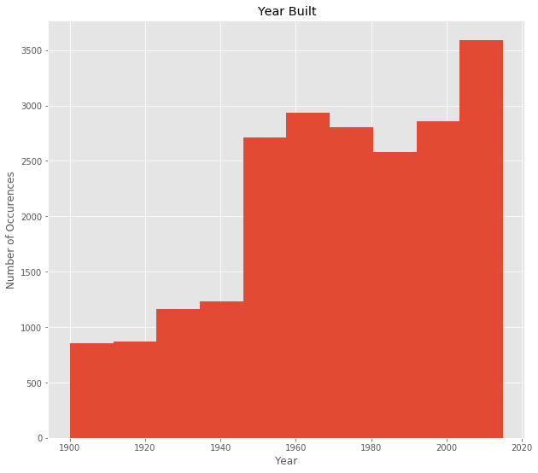
Solution: Binning
Reduce complexity: Keep only which decade house belongs to
Create new features representing each bin
Linear model captures time affect – Performs better

Slide 8
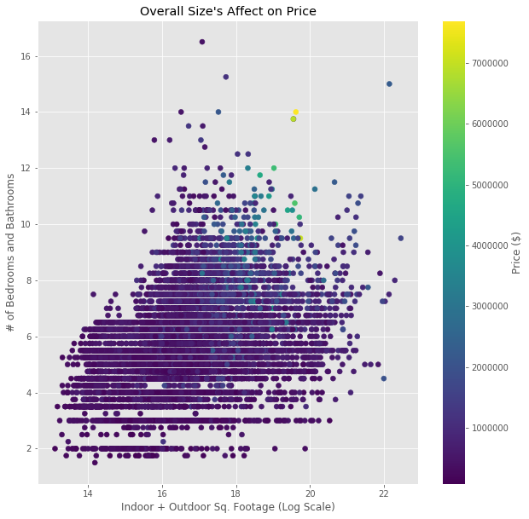
The Model
Best Features:
Number of Total Rooms & Floors
Indoor Sq. Footage
Overall Condition
Location
Year Built
Achieved R^2 Score of
~0.76 on Test Set
~0.77 on Training Set
Results:
Housing prices are volatile, so these results are good for a linear model
(See how spread out visual is)

Slide 9
Main Takeaways
Feature engineering + Log scaling:
Achieved higher R2: ~17% improvement over raw data model
All features statistically significant – will perform well on unseen data
Recommendation:
Keep recording data in same way
Model depends highly on clustering – try many different clusters
Use provided techniques to transform data
Retrain model with more data, specifically with more expensive homes
Things to watch for:
As houses get more expensive, price becomes harder to predict

